Slide 1
Whitman College
Climate Matters
April 10, 2015

Slide 2
Campuses as Social Systems
Institutional History/Core Values
Institutional Policies
Structural Framework
Students, Faculty, Staff, Alumni
Social Contexts
Vision/Mission
Harper & Hurtado, 2009; Smith, 2010

Slide 3
Climate In Higher Education
Climate (Living, Working, Learning)
Community Members
Create and Distribute Knowledge
Barcelo, 2004; Bauer, 1998, Kuh & Whitt, 1998; Hurtado, 1998, 2005; Ingle, 2005; Milhem, 2005; Peterson, 1990; Rankin, 1994, 1998, 2003, 2005; Rankin & Reason, 2008; Smith, 2009; Tierney, 1990; Worthington, 2008

Slide 4
Assessing Campus Climate
What is it?
Campus Climate is a construct
Definition?
Current attitudes, behaviors, and standards and practices of employees and students of an institution
How is it measured?
Personal Experiences
Perceptions
Institutional Efforts
Rankin & Reason, 2008

Slide 5
Campus Climate & Students
How students experience their campus environment influences both learning and developmental outcomes.¹
Discriminatory environments have a negative effect on student learning.²
Research supports the pedagogical value of a diverse student body and faculty on enhancing learning outcomes.³
¹ Pascarella & Terenzini, 1991, 2005
² Cabrera, Nora, Terenzini, Pascarella, & Hagedron, 1999; Feagin, Vera & Imani, 1996; Pascarella & Terenzini, 2005
³ Hale, 2004; Harper & Quaye , 2004; Harper, & Hurtado, 2009; Hurtado, 2003.

Slide 6
Campus Climate & Faculty/Staff
The personal and professional development of employees are impacted by campus climate.¹
Faculty members who judge their campus climate more positively are more likely to feel personally supported and perceive their work unit as more supportive.²
Research underscores the relationships between (1) workplace discrimination and negative job and career attitudes and (2) workplace encounters with prejudice and lower health and well-being..³
¹Settles, Cortina, Malley, and Stewart (2006)
²Sears, 2002
³Silverschanz, Cortina, Konik, & Magley, 2007; Waldo, 1999

Slide 7
Assessing Campus Climate
Why Assess?
What is the Process?
Where Do We Start?

Slide 8
Why conduct a climate assessment?
To foster a caring university community that provides leadership for constructive participation in a diverse, multicultural world.
To open the doors wider for under-served constituents to create a welcoming environment.
To improve the environment for working and learning on campus.

Slide 9
Campus Climate & Successful Outcomes
Positive Experiences with Campus Climate
Positive
Perceptions of Campus Climate
Success
For Students:
Positive educational experiences
Healthy identity development
Overall well-being
For Faculty & Staff:
Productivity
Sense of value & community
Overall well-being
Persistence
&
Retention

Slide 10
Whitman College
Mission
Whitman College is committed to providing an excellent, well-rounded liberal arts and sciences undergraduate education. It is an independent, nonsectarian, and residential college. Whitman offers an ideal setting for rigorous learning and scholarship and encourages creativity, character, and responsibility.
Through the study of humanities, arts, and social and natural sciences, Whitman's students develop capacities to analyze, interpret, criticize, communicate, and engage. A concentration on basic disciplines, in combination with a supportive residential life program that encourages personal and social development, is intended to foster intellectual vitality, confidence, leadership, and the flexibility to succeed in a changing technological, multicultural world.
Source: https://www.whitman.edu/about-whitman/mission-statement

Slide 11
Whitman College
Statement on Diversity
Diversity is fundamentally important to the character and mission of Whitman College. Diversity enriches our community and enhances intellectual and personal growth. We seek to provide a challenging liberal arts experience for our students that prepares them for citizenship in the global community. By sustaining a diverse community, we strive to ensure that all individuals are valued and respected and that intellectual and personal growth are enriched because of our differences.
Source: https://www.whitman.edu/about-whitman/diversity/trustee-statement

Slide 12
Conceptual Framework for Campus Diversity Research
Campus Climate
and Inter-group
Relations
DIMENSIONS
OF
CAMPUS
DIVERSITY
Representation
(Access & Success)
Education &
Scholarship
(Curriculum, Teaching,
& Learning)
Institutional
Transformation
(Viability & Vitality)
Smith, 1999; 2009

Slide 13
Components of Campus Climate
Government/Policy Context
Sociohistorical Context
Historical Legacy of Inclusion/Exclusion
Compositional Diversity
(The Numbers)
Organizational/
Structural
(Campus Policy)
Psychological Climate
(Feelings and Emotions)
Behavioral Dimension
(Interactions and Practices)
Milem, Chang, & Antonio (2005) adapted fromHurtado, Milem, Clayton-Pedersen, & Allen (1999)

Slide 14
Rankin 2001
National Campus Climate Diversity Assessment
NASPA/NGLTF Grants
Underrepresented/underserved faculty/staff/students
30 Campuses
Survey Instrument
Meta-analysis of diversity assessment tools from 35 institutions
Paper/Pencil only

Slide 15

Transformational Tapestry Model©
Access
Retention
Assessment
University
Policies/Service
Research
Scholarship
Baseline
Organizational
Challenges
Systems
Analysis
Local / Sate /
Regional
Environments
Current Campus Climate
Contextualized Campus Wide Assessment
Curriculum
Pedagogy
Intergroup &
Intragroup
Relations
Advanced
Organizational
Challenges
Consultant
Recommendations
External
Relations
Access
Retention
Symbolic
Actions
University
Policies/Service
Research
Scholarship
Transformation
via
Intervention
Transformed Campus Climate
Educational
Actions
Fiscal
Actions
Administrative
Actions
Curriculum
Pedagogy
Intergroup &
Intragroup
Relations
External
Relations
© 2001

Slide 16
Recent Climate Research
1999-2014 Campus Climate Assessments
2010 State of Higher Education for LGBTQ People
2011 NCAA Student-Athlete Climate Study
2014 International Athlete Survey
2015 United States Transgender National Survey

Slide 17
R&A Campus Climate Assessments 1999-2015
Source: www. rankin-consulting.com

Slide 18


Slide 19
Behavioral Responses - Persistence
Respondents seriously considered leaving their institution due to the challenging climate:
One-third of Queer spectrum respondents (33%)
One-third of Trans-spectrum respondents (38%)

Slide 20
Behavioral Responses - Substance Use & Abuse
Having at least one alcohol or drug abuse disorder (DSM IV TR)
Internalized homophobia
Heterosexist events
F(1,757) = 10.18
F(1,757) = 4.40
p < .01
(Weber, 2008)

Slide 21

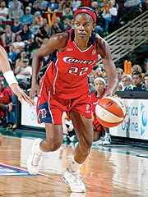
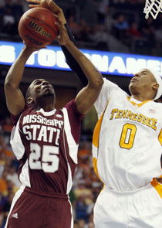
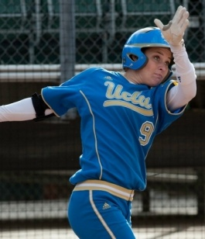

Student-Athlete Climate Study
This project is supported by a grant from the NCAA

Slide 22
SACS Conceptual Framework

Slide 23
SEM Mediation Model

Slide 24
Gender – Direct Effects Model
p < .001
Women student-athletes have significantly greater levels of academic and athletic success and lower levels of athletic identity compared to men student-athletes

Slide 25
Gender - Mediation Effects on Outcomes
p < .001

Slide 26
Women Student-Athletes
Gender Matters
Gender significantly predicts academic success and athletic success.
Climate Matters
Women student-athletes report greater levels of athletic success than men student-athletes
Women student-athletes report greater levels of academic success than men student-athletes
The following climate factors significantly influenced academic success for women student-athletes
Perceptions of climate
Faculty-student interaction
Personal comfort with teammate diversity
Perceptions of respect

Slide 27
Review of Climate Assessment Process
Whitman College Summary

Slide 28
Project Outcomes
Whitman College will add to their knowledge base with regard to how students, faculty, and staff currently experience the campus climate.
Whitman College will use the results of the assessment to inform current/on-going work regarding issues of campus climate for students, faculty, and staff.

Slide 29
PHASE I
Initial Proposal Meeting
Focus Groups

Slide 30
Focus Groups
Identify the focus groups
Develop the protocol for the focus groups
Populate the focus groups
Focus group facilitators are selected and trained by the consultant

Slide 31
PHASE II
Assessment Tool Development
Communication/Marketing Plan
IRB proposal

Slide 32
Survey Instrument
Final instrument
Quantitative questions and additional space for respondents to provide commentary
Sample = Population
All members of the university community are invited to participate via an invitation from the President
Web-based survey

Slide 33
SAMPLE CONCEPT MAP
IDENTITY EXAMPLES
CLIMATE
OUTCOMES
Position Status
Experiences
Racial Identity
Professional Success
Gender Identity
Perceptions
Sexual Identity
Intent to Persist
disAbility Status
Institutional Actions
SES status
Spiritual identity

Slide 34
Communication Plan
Preparing the University Community
    Talking points
    Incentives
    Invitation letter
    Subsequent invitations to participate

Slide 35

Institutional Review Board
Proposal application
Primary Investigator from Whitman College

Slide 36
PHASE III
Survey Implementation
Data Analysis

Slide 37
SAMPLE Response Rates
Demographics of Population & Sample
Whitman College
Spring 2016
Faculty |  | Man | Woman |  | African American | Native American | Asian American | Latino(a) American | European American | Unknown
Professor
Associate Professor
Assistant Professor
Instructor
Adjunct Faculty

Slide 38
PHASE IV
Final Report
Presentation of Results

Slide 39
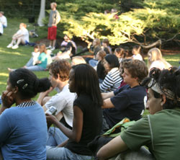

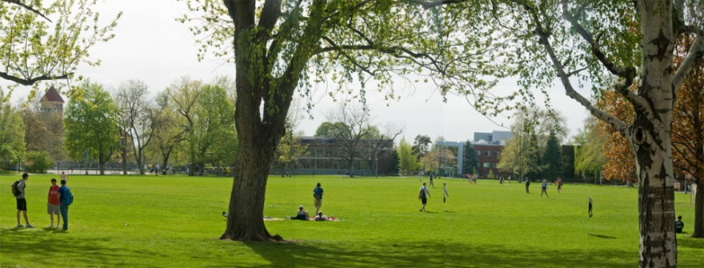
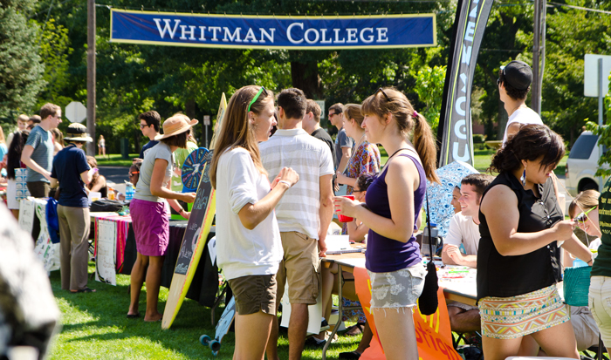
Next Steps

Slide 40
Projected Process Forward
April 2015
Initial meeting with Climate Study Working Group (CSWG)
May-August 2015
Plan Focus Groups
Begin survey development

Slide 41
Projected Process Forward
Conduct Focus Groups
November-December 2015
Complete survey instrument
September-October 2015
Submit IRB proposal
Develop Communication plan

Slide 42
Projected Process Forward
February 2016
Survey administration
March-May 2016
Data Analysis

Slide 43
Projected Process Forward
June-August 2016
Develop report
September-October 2016
Presentation of Report

Slide 44
Projected Process Forward
November - December 2016
Develop Strategic Actions
Actions Implementation
2016-2017

Slide 45
Questions..?
Thoughts..?

Slide 46
Thank You!
For more information contact:
    Susan (Sue) Rankin
    Rankin & Associates, Consulting
    sxr2@psu.edu

